Slide 1
Reporting
Degree Works
Data
Michael Moore, PhD
Associate Registrar,
Old Dominion University
SESSION ID: DWF253522
Notes:
My name is Michael Moore and today we are going to look at reporting Degree Works data

Slide 2
Disclaimer
The views and opinions in this presentation are those of the presenter and do not necessarily reflect the position of Ellucian.

Slide 3
Introduction
Learn about the tables in the Degree Works database
Introduce reporting out Degree Works data
Notes:
We’ll cover two main topics: the tables that are in the Degree Works database and how to report out that data

Slide 4
Assumptions
Familiar with a database and related terms
Some experience querying data
Have query access to all DW tables
Notes:
I am making some assumptions about you all today. One, I am assuming everyone is familiar with a relational database and related terms, just not necessarily the Degree Works database. I am also assuming you have experience querying data using SQL. I will explain the decisions I made when writing the SQL, just not what the different clauses mean. Finally, you will need to have query access to all of the Degree Works tables, so I am assuming you do.

Slide 5
Important Notes
Examples are general and not comprehensive
SQL needs to be localized to your environment
Notes:
Before we get started, there are some important things you need to take note of. First, the examples in this presentation are general and not comprehensive. The reason for this is everyone’s data needs are different. The examples presented here are meant to spark inspiration and get you started. Also, the SQL presented here is only illustrative. It will not work as writing because my environment is different than yours. Although the columns and tables are accurate, you must localize the SQL to your environment.

Slide 6
Agenda
1 | About Old Dominion University
2 | About the Tables
3 | General Student Data
4 | Course Planning with SEP
5 | Graduation and Missing Requirements
Notes:
And with that business out of the way, let’s review the agenda

Slide 7
About Old Dominion University
Notes:
First up, just a brief background on ODU

Slide 8
About Old Dominion University
22,000 students
274 programs (bachelor, post-bac, master, doctoral, certificate)
3 Degree Works Staff
Live since 2009
Version 4.1.6
Use MS Access for reporting
Notes:
We have 22,000 students in 274 different programs at all different levels. We have three full time Degree Works staff. We have been living for a decade now, though we are still on version 4.1.6 (just waiting for 5.0.2!) Finally, while other schools use fancy tools like Argos or Cognos or even Toad, we are using Microsoft Access for reporting. It works really well for us and might work well for you too!

Slide 9
About the Tables
Notes:
Now let’s learn a little about the tables in the Degree Works database

Slide 10
Types of Tables
CPA – Curriculum Planning Assistant
DAP – Degree Audit
RAD – Academic Data from SIS
SEP – Student Educational Planner
Not Covered
SHP – Shepard Settings
UCX – SureCode Settings
Notes:
There are six types of tables in the Degree Works database, four of which we will be covering today, including…The tables we will not be covering are…because you can easily see this information in DW Shell

Slide 11
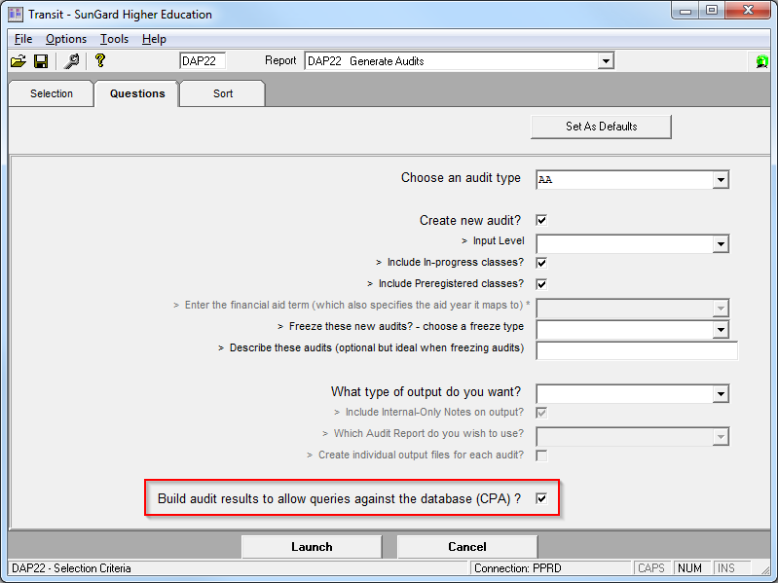
CPA and DAP Data
Can be set to
populate nightly
Also populated by
DAP22 job in
Transit
Can take a long
time to run
Notes:
The CPA and DAP tables can be set to populate nightly or you can use the DAP22 in Transit. If you are using Transit, be sure to check the “Build audit results to allow queries against the database (CPA)?” box. In either case, it can take a long time to run. In our case, when we tried to populate it nightly, it was never able to finish because we simply had too many students. Because of this, we only populate for certain populations on an as-needed basis

Slide 12

CPA and DAP Data
Does not overwrite existing data
Can get very large
Safe to truncate
Notes:
Another few things to note about the CPA and DAP tables: each time they are populated, they do not overwrite existing data. Because of this they can get very large. Plus you may be querying outdated data. However, the tables are safe to truncate, which your IT staff may have to do for you.

Slide 13
RAD and SEP tables
RAD tables are populated when data is bridged from the SIS
SEP tables are populated when a change is made to the student’s plan on the dashboard
Notes:
Nothing needs to be done to get data into the RAD and SEP tables. RAD updates when data is bridged from your SIS and SEP updates when someone changes the plan from within the degree audit dashboard

Slide 14
General Student Data
No, not SGASTDN
Notes:
Now that we know what tables hold what data, we can start to query the data. Let’s start by looking at some general student data

Slide 15
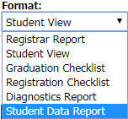
Student Data Report
Can learn a lot about where data is from Student Data Report
Notes:
Probably everyone is familiar with the Student Data Report that can be accessed from the Degree Works dashboard. This is actually a good place to start when you are looking for data. A lot of basic information can be found on the Student Data Report

Slide 16
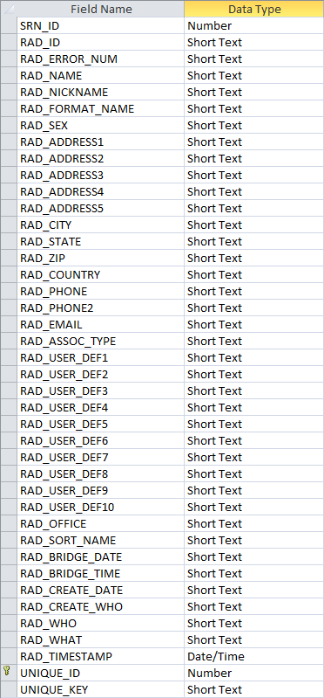
RAD_PRIMARY_MST
Notes:
The first table in the student data report is the Primary-Mst table or RAD_PRIMARY_MST as it is named in the Degree Works database. As you can see from the screenshot of the table in the Student Data Report, it does not contain all the information as seen in the design of the RAD_PRIMARY_MST table. Therefore, it is important to look at all of the data in the table to get a clear understanding of what is available.

Slide 17
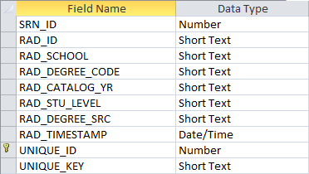
RAD_GOAL_DTL
Notes:
Next up is Goal-Dtl or RAD_GOAL_DTL. This table is fairly light on data, but we can see it provides the degree, catalog, and student level

Slide 18
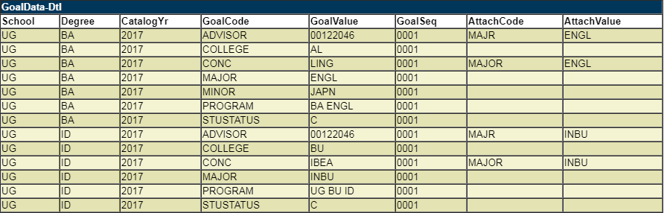
RAD_GOALDATA_DTL
Notes:
GoalData-Dtl or RAD_GOALDATA_DTL is similar to RAD_GOAL_DTL but provides a lot more information. We can see it uses GoalCode to help us decipher what is in GoalValue-Dtl. Interestingly, it has dedicated columns for degree and catalog year, data we saw already in RAD_GOAL_DTL

Slide 19
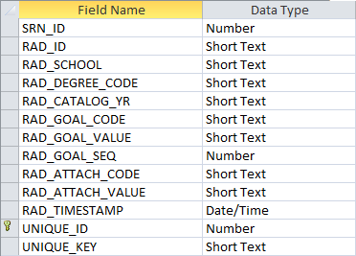
RAD_GOALDATA_DTL
Notes:
Here is the design of the RAD_GOALDATA_DTL table.

Slide 20
RAD_GOAL_DTL vs RAD_GOALDATA_DTL
Which one to use?
RAD_GOALDATA_DTL
Notes:
So as we saw, both RAD_GOAL_DTL and RAD_GOALDATA_DTL share similar data. So which one should we use? My recommendation is RAD_GOALDATA_DTL

Slide 21
RAD_GOAL_DTL vs RAD_GOALDATA_DTL
RAD_GOAL_DTL
Contains a limited amount of data
Repeats data found elsewhere
Does contain student level (classification)
Notes:
RAD_GOAL_DTL has limited information. Say initially we only needed to know the degree and catalog year. It would be easy to use RAD_GOAL_DTL to get this. But later if we needed to add major, we would have to go to another table. We could just start with RAD_GOALDATA_DTL so we would have a way to expand our query in the future. One thing to note is that is does contain the student level or classification.

Slide 22
RAD_GOAL_DTL vs RAD_GOALDATA_DTL
RAD_GOALDATA_DTL
Contains a many data points not found elsewhere
Needs to be joined to itself to get a complete picture of student curriculum
Notes:
One drawback to RAD_GOALDATA_DTL is that it has multiple rows to hold all the data. Rather than having columns named MAJOR or MINOR, we have to set that as criteria in RAD_GOAL_CODE. Because of this, we need to join RAD_GOALDATA_DTL to itself to understand a student’s curriculum

Slide 23
RAD_GOALDATA_DTL
Notes:
Let me explain. If we look at RAD_GOALDATA_DTL for this example student, we see that there are two different degrees, BA and ID, which each have their own associated MAJOR, CONC, and so on

Slide 24
SQL
Find majors and concentrations
SELECT rad_goaldata_dtl.rad_id, rad_goaldata_dtl.rad_goal_code, rad_goaldata_dtl.rad_goal_value
FROM rad_goaldata_dtl
WHERE rad_goaldata_dtl.rad_goal_code='MAJOR' OR
rad_goaldata_dtl.rad_goal_code='CONC';
Notes:
So let’s do a quick query to find the majors and concentrations in RAD_GOALDATA_DTL. We set our criteria for RAD_GOAL_CODE to either be MAJOR or CONC

Slide 25
Results
PROBLEMS
Majors and concentrations in their own row
Unclear which concentration goes to which major
Notes:
But we review the results for this student, we see that each major has its own row as does each concentration. It is not readily apparent which goes to which.

Slide 26
RAD_GOALDATA_DTL
Solution: join RAD_GOALDATA_DTL to itself
Notes:
But if we look back at the RAD_GOALDATA_DTL table, we can see there is an AttachCode and AttachValue for each CONC. This tells us (and our query) which CONC goes to which MAJOR. We can join on these values to get better results

Slide 27
SQL
SELECT rad_goaldata_dtl.rad_id,
rad_goaldata_dtl.rad_goal_code,
rad_goaldata_dtl.rad_goal_value,
rad_goaldata_dtl_1.rad_goal_code,
rad_goaldata_dtl_1.rad_goal_value
FROM rad_goaldata_dtl, rad_goaldata_dtl as rad_goaldata_dtl_1
WHERE rad_goaldata_dtl.rad_id=rad_goaldata_dtl_1.rad_id AND rad_goaldata_dtl.rad_goal_code=rad_goaldata_dtl_1.rad_attach_code AND rad_goaldata_dtl.rad_goal_value=rad_goaldata_dtl_1.rad_attach_value AND rad_goaldata_dtl_1.rad_goal_code='CONC';
Notes:
Notice in this query, we bring in two versions of RAD_GOALDATA_DTL, aliasing one with a different name. The first version will be the one we return the MAJOR from while the second will be our CONC. Then in our WHERE criteria, we can join the first table’s RAD_GOAL_CODE to the second table’s RAD_ATTACH_CODE. Remember that the CONC row had a value of MAJOR in RAD_ATTACH_CODE. The we join RAD_ATTACH_VALUE to RAD_ATTACH_VALUE, recalling that RAD_ATTACH_VALUE has the actual major code in it

Slide 28
Results
Notes:
Now in our results, we get a much cleaner look which each major and conc pair getting their own row. Now if you were going to do this query for real, you would of course want to account for majors where this no concentration.

Slide 29
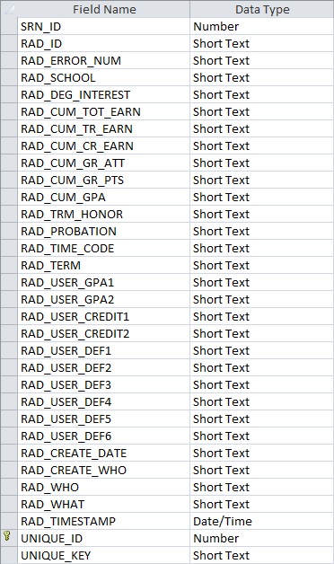
RAD_TERM_DTL
Notes:
Term-Dtl or RAD_TERM_DTL contains good information regarding the GPA and credits earned.

Slide 30
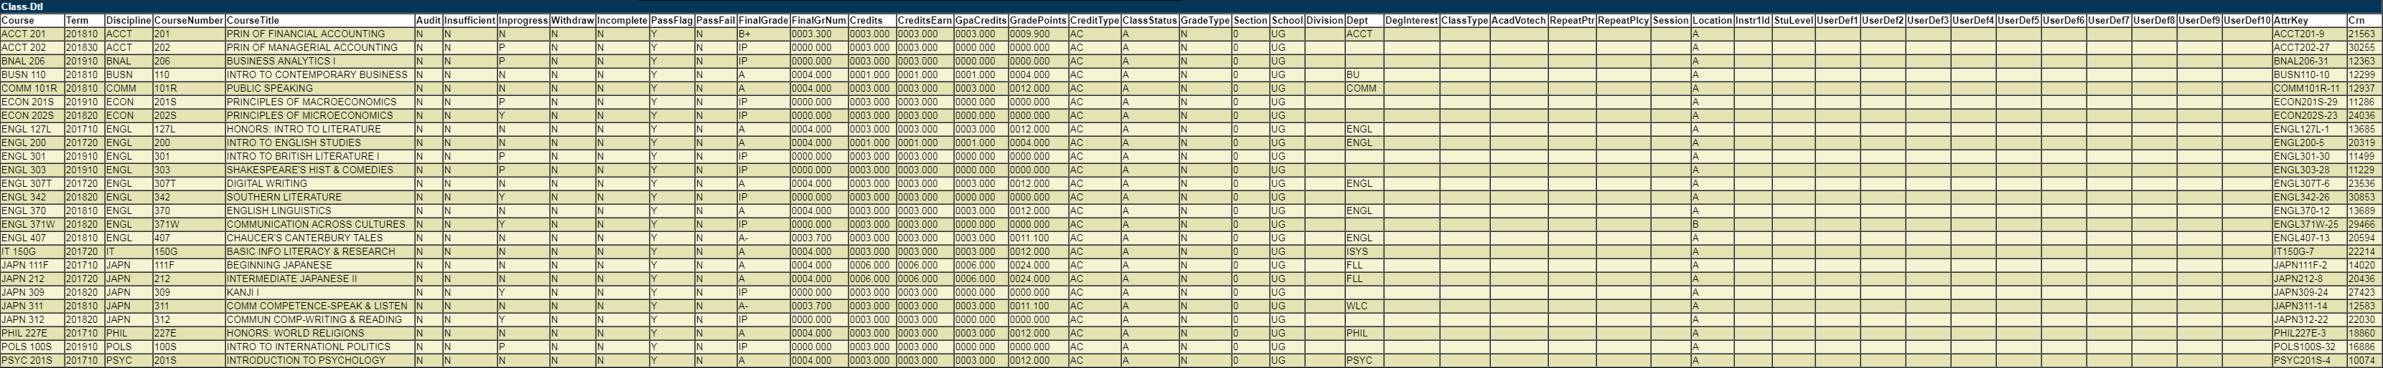
RAD_CLASS_DTL
Notes:
This giant table with tiny text is Class-Dtl or RAD_CLASS_DTL. This contains a complete listing of all the classes the student has taken, is taking, and is pre-registered for. Note that it is the classes taken at your institution. Transferred classes are in another table Transfer-Dtl or RAD_TRANSFER_DTL which is similar.

Slide 31
SQL
What classes is a student enrolled in this semester?
SELECT rad_class_dtl.rad_id,
rad_class_dtl.rad_course_key,
rad_class_dtl.rad_term,
rad_class_dtl.rad_final_grade
FROM rad_class_dtl
WHERE rad_class_dtl.rad_term='201820' AND
rad_class_dtl.rad_final_grade<>'W';
Notes:
So let’s use the RAD_CLASS_DTL table to determine which classes students are enrolled in this semester.

Slide 32
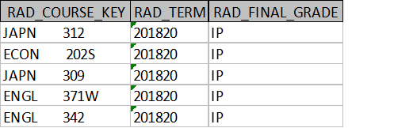
Results
Notes:
And here are the results for one particular student.

Slide 33

RAD_CLASS_DTL
Note that RAD_COURSE_KEY is a concatenation of
Discipline and CourseNumber
Notes:
As we can see from Class-Dtl from the Student Report Data, the course is in two columns: Discipline and CourseNumber. But in RAD_CLASS_DTL, the discipline and number is concatenated in RAD_COURSE_KEY with extra spaces between the two.

Slide 34
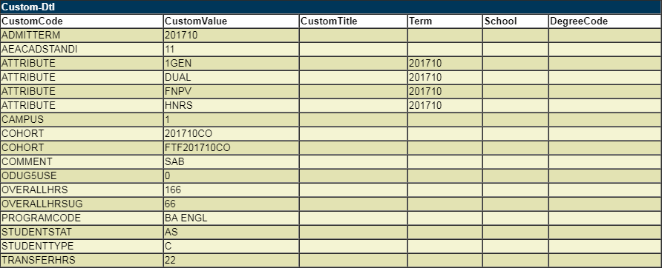
RAD_CUSTOM_DTL
Notes:
The next table up is Custom-Dtl or RAD_CUSTOM_DTL. Note that the CustomCode provides the description of the data in CustomValue

Slide 35
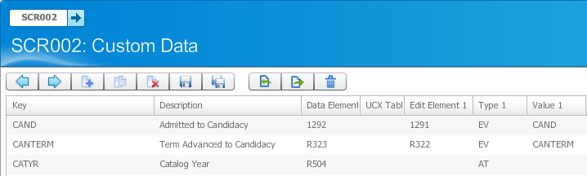
RAD_CUSTOM_DTL
Populated based on entries in SCR002
Not every student will have a value for every entry in SCR002
Notes:
The custom codes come from SCR002 that you define. We won’t get into the background of SCR002 today, but note that just because you define a code on SCR002, it doesn’t mean every student will have that code

Slide 36
Even more…
There are many other student data tables to be found on the Student Data Report. See what you can find!
Notes:
We did not cover every table in the Student Data Report or even in the RAD table group. So I would encourage you all to explore these tables in more detail.

Slide 37
Course Planning with SEP
Predicting Demand
Notes:
We can also report out of the SEP tables to do things such as predicting course demand

Slide 38
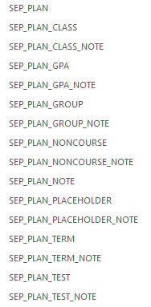
SEP Tables
Notes:
There are a number of SEP tables but we will only be covering a few of them today. So again, be sure to explore these on your own

Slide 39
SEP Tables
There are also SEP_TMPL tables that contain template data
Not covered in this presentation
Notes:
There is a SEP_TMPL group that you can report out template data, but we won’t be looking at those either

Slide 40
SQL
Who has an active, locked plan?
SELECT sep_plan.student_id,
sep_plan.description,
sep_plan.is_active,
sep_plan.is_locked
FROM sep_plan
WHERE sep_plan.is_active='Y' AND
sep_plan.is_locked='Y';
Notes:
So what are we looking at? Well, as I mentioned, we can predict course demand. But in order for that to work, we need to ensure as many students as possible have an approved plan. At ODU, we require the student to flag one plan as active, and the advisor to lock it once it is approved. So let’s start by first determining who has an active, locked plan

Slide 41
Results
Notes:
Here are just a few student plan description. Actually some of the plan descriptions can be quite humorous.

Slide 42
SQL
How many students are planning to take MGMT 325 in Fall?
Need three tables
SEP_PLAN
SEP_PLAN_TERM
SEP_PLAN_CLASS
Notes:
Now that we know who has a plan, let’s turn to determining who is planning to take a particular course. We need to look at three different tables to get this data

Slide 43
SQL
SELECT sep_plan_class.course_discipline,
sep_plan_class.course_number,
count(sep_plan.student_id as countofstudent_id)
FROM sep_plan, sep_plan_class, sep_plan_term
WHERE sep_plan.is_active='Y' AND
sep_plan.is_locked='Y' AND
sep_plan_term.term='201910' AND
sep_plan_class.group_id=sep_plan_term.group_id AND
sep_plan_term.plan_id=sep_plan.plan_id
GROUP BY sep_plan_class.course_discipline, sep_plan_class.course_number
HAVING sep_plan_class.course_discipline='MGMT' AND
sep_plan_class.course_number='325';
Notes:
Here is our SQL

Slide 44
Results
Notes:
And from this we can see that 112 students are planning to take MGMT 325 in the fall. We can pass this on to the business school so they can plan to offer enough seats to meet student demand

Slide 45
SQL
What are most planned for courses?
SELECT sep_plan_class.course_discipline,
sep_plan_class.course_number,
count(sep_plan.student_id as countofstudent_id)
FROM sep_plan, sep_plan_class, sep_plan_term
WHERE sep_plan.is_active='Y' AND
sep_plan.is_locked='Y' AND
sep_plan_term.term='201910' AND
sep_plan_class.group_id=sep_plan_term.group_id AND
sep_plan_term.plan_id=sep_plan.plan_id
GROUP BY sep_plan_class.course_discipline, sep_plan_class.course_number;
Notes:
We can also look broadly to see what the most popular courses are

Slide 46
Results
Notes:
And here we can see that our second level English composition is top of the list for fall, followed by statistics, literature, calculus, and physics

Slide 47
SQL
What courses are cybersecurity students planning to take?
Need four tables
SEP_PLAN
SEP_PLAN_TERM
SEP_PLAN_CLASS
RAD_GOALDATA_DTL
Notes:
Let’s get a little more specific and see what courses students in a certain major are planning to take. In additional to the previous three tables, we’ll also look at RAD_GOALDATA_DTL which we saw earlier

Slide 48
SQL
SELECT sep_plan_class.course_discipline,
sep_plan_class.course_number,
count(sep_plan.student_id as countofstudent_id)
FROM sep_plan, sep_plan_class, sep_plan_term, rad_goaldata_dtl
WHERE sep_plan.is_active='Y' AND
sep_plan.is_locked='Y' AND
sep_plan_term.term='201910' AND
sep_plan_class.group_id=sep_plan_term.group_id AND
sep_plan_term.plan_id=sep_plan.plan_id AND
sep_plan.student_id=rad_goaldata_dtl.rad_id AND
rad_goaldata_dtl.rad_goal_code='MAJOR' AND
rad_goaldata_dtl.rad_goal_value='CYBR'
GROUP BY sep_plan_class.course_discipline, sep_plan_class.course_number;

Slide 49
Results
Notes:
Now we can see the most popular course for cybersecurity students in the writing intensive course, followed by CYSE and IT courses.

Slide 50
SQL
Which cybersecurity majors do not have a plan for Fall?
Need three tables
SEP_PLAN
SEP_PLAN_TERM
RAD_GOALDATA_DTL
Need two queries
One to identify who does have a plan
Use that as criteria for second query
Notes:
As I said, ODU requires all students to make a plan to get their registration hold lifted. This does not mean they all do it though, so we can run a query to see which students do not have a plan. We use three tables we’ve seen before to make two queries. The first query contains the students who do have a plan while the second makes use of those results to find the students without a plan

Slide 51
SQL
SELECT rad_goaldata_dtl.rad_id,
rad_goaldata_dtl.rad_goal_code,
rad_goaldata_dtl.rad_goal_value
FROM rad_goaldata_dtl
WHERE rad_goaldata_dtl.rad_id NOT IN (SELECT sep_plan.student_id
FROM sep_plan, sep_plan_term, rad_goaldata_dtl
WHERE sep_plan.is_active='Y' AND
sep_plan.is_locked='Y' AND
sep_plan_term.term='201910' AND
sep_plan_term.plan_id=sep_plan.plan_id AND
sep_plan.student_id=rad_goaldata_dtl.rad_id AND
rad_goaldata_dtl.rad_goal_code='MAJOR' AND
rad_goaldata_dtl.rad_goal_value='CYBR';) AND
rad_goaldata_dtl.rad_goal_code='MAJOR' AND
rad_goaldata_dtl.rad_goal_value='CYBR';
Notes:
Let’s look at the query in red first

Slide 52
Results
Notes:
And these are IDs of the three students we need to reach out to and remind them to make a plan

Slide 53
Other Considerations
Choice
Test
Noncourse
Placeholder
Notes
Notes:
So we only look at the COURSE plan type. It’s important to remember there other plan types including…Querying these will require more complex SQL than shown here.

Slide 54
Graduation and Missing Requirements
and Exceptions, too
Notes:
Let’s move on to look at graduation and missing requirements as well as exceptions

Slide 55
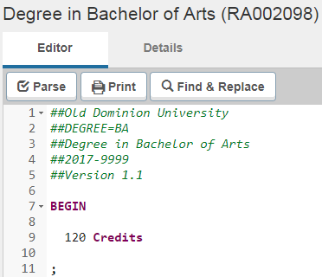
CPA_BLOCKCRCLNEEDED Table
Notes:
We talked about how the CPA tables get populated earlier, but let’s look now at where that data comes from. First up is the CPA_BLOCKCRCLNEEDED table. We can look at Scribe for a particular block

Slide 56
CPA_BLOCKGPA
Notes:
CPA_BLOCKGPA will provide the completeness of the audit overall as well as the completeness of the particular block, be it degree, major, minor, etc. Here we are only looking at one block, degree. If we compare it to the audit, we can see the Program Progress bar percent is going into PCT_COMPLETE_STRING and PCT_COMPLETE_NUM. Now we use Degree as Program at ODU, so the program progress bar matches the percentage that the DEGREE block is complete. We can see the GPA going into the GPA_STRING and GPA_NUM columns.

Slide 57
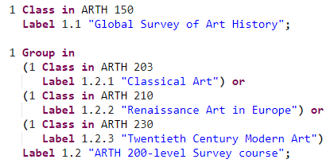
CPA_BLOCKLABELS
Notes:
In CPA_BLOCKLABELS we can match those to the Scribed rules

Slide 58
CPA_CLASSAPPLIED
Notes:
In CPA_CLASSAPPLIED, we can see which course is being applied to a particular rule in a particular block

Slide 59
CPA_BLOCKLABELS + CPA_CLASSAPPLIED
Who completed a requirement labeled Global Survey of Art History and what course is applied?
Notes:
So using these two tables, we can answer this question.

Slide 60
SQL
SELECT cpa_classapplied.stu_id,
cpa_blocklabels.req_id,
cpa_blocklabels.rule_id,
cpa_blocklabels.label_text,
cpa_classapplied.course_key
FROM cpa_classapplied, cpa_blocklabels
WHERE cpa_blocklabels.req_id=cpa_classapplied.req_id AND cpa_blocklabels.rule_id=cpa_classapplied.rule_id AND cpa_blocklabels.label_text='Global Survey of Art History';

Slide 61
Results

Slide 62
CPA_BLOCKLABELS + CPA_CLASSAPPLIED
Who completed ARTH 150 and what is the label of the requirement it applied to?
Notes:
We can flip the question and ask where a particular course is applying

Slide 63
SQL
SELECT cpa_classapplied.stu_id,
cpa_blocklabels.req_id,
cpa_blocklabels.rule_id,
cpa_blocklabels.label_text,
cpa_classapplied.course_key
FROM cpa_classapplied, cpa_blocklabels
WHERE cpa_blocklabels.req_id=cpa_classapplied.req_id AND cpa_blocklabels.rule_id=cpa_classapplied.rule_id AND cpa_classapplied.course_key ='ARTH 150';

Slide 64
Results

Slide 65
DAP_AUDIT_DTL
Up to 10 different block results are available
Next slide only shows one block result
Notes:
DAP_AUDIT_DTL has 10 sets of columns for up to 10 different blocks. In the next slide, we’ll focus on one block, but the concept is the same for the other blocks

Slide 66
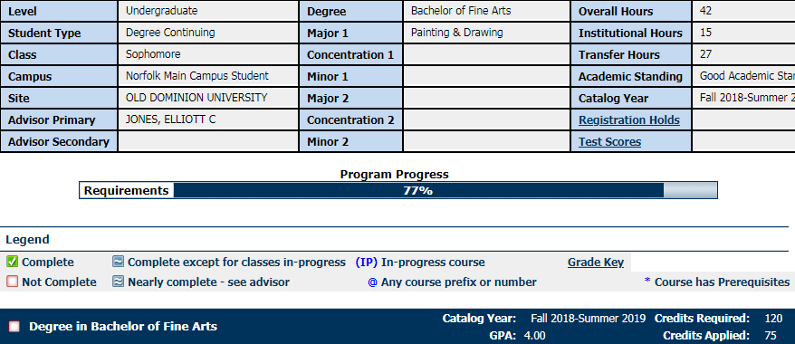
DAP_AUDIT_DTL
Notes:
Let’s first look at where the data comes from.

Slide 67
SQL
Who is at 100% and should be graduated?
SELECT dap_audit_dtl.dap_stu_id, dap_audit_dtl.dap_degree, dap_audit_dtl.dap_audit_pct
FROM dap_audit_dtl
WHERE dap_audit_dtl.dap_audit_pct='100';
Notes:
Now that we have an understanding of the table, let’s query it to find out who is ready to be graduated

Slide 68
Results
Notes:
We can use these IDs to award the degrees

Slide 69
DAP_RESULT_DTL
Sums up all the CPA data
Next slides will look at one block for one student
Notes:
DAP_RESULT_DTL sums up all the data generated by the CPA. And there is a lot of data. The next slides will look at one student

Slide 70
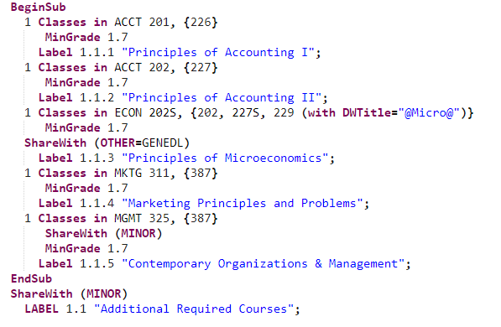
DAP_RESULT_DTL
Notes:
We’re going to isolate even further and just look at one block. Here is the Scribe

Slide 71
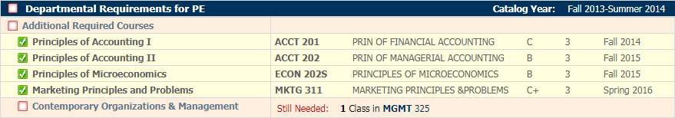
DAP_RESULT_DTL
Notes:
And here is how it appears on the Degree Audit for our one student. We can see she only has one requirement remaining

Slide 72
DAP_RESULT_DTL
Notes:
Here is the DAP_RESULT_DTL data for this one block

Slide 73
DAP_RESULT_DTL
Notes:
First let’s look at the header of the block. We can see that even though we are not displaying a GPA or class/credits required, it is still being calculated in the table

Slide 74
SQL
Who is not meeting the minimum GPA for a major/minor?
SELECT DAP_RESULT_DTL.DAP_STU_ID, DAP_RESULT_DTL.DAP_REQ_ID, DAP_REQ_MST.DAP_BLOCK_TYPE, DAP_REQ_MST.DAP_REQ_TITLE, DAP_RESULT_DTL.DAP_RESULT_TYPE, DAP_RESULT_DTL.DAP_NUMBER2
FROM DAP_RESULT_DTL, DAP_REQ_MST
WHERE DAP_RESULT_DTL.DAP_REQ_ID=DAP_REQ_MST.DAP_REQ_ID AND
DAP_REQ_MST.DAP_BLOCK_TYPE=‘MAJOR‘ AND
DAP_RESULT_DTL.DAP_RESULT_TYPE=‘BLOCKGPA’ AND
DAP_RESULT_DTL.DAP_NUMBER2<2;
Notes:
So knowing that, we could query this table to find out who is not meeting a minimum GPA

Slide 75
Results
Notes:
All of our undergraduate majors require 2.0 minimum, so we can look for those with less than 2.0

Slide 76

DAP_RESULT_DTL
Notes:
Next up is the Subset label

Slide 77

DAP_AUDIT_DTL
Notes:
Let’s now look at a completed requirement

Slide 78

DAP_RESULT_DTL
Notes:
And now an incomplete requirement

Slide 79
DAP_RESULT_DTL
What is the difference between a complete and an incomplete requirement?

Slide 80
DAP_RESULT_DTL
Notes:
It comes down to the difference in DAP_RESULT_TYPE. Note also for the incomplete requirement, DAP_VALUE4 lists MAYTAKE

Slide 81
RAD_RESULT_DTL
MUSTTAKE – this is the only option
MAYTAKE – one option of many

Slide 82
SQL
What requirements are students missing?
SELECT DAP_RESULT_DTL.DAP_STU_ID, DAP_RESULT_DTL.DAP_RESULT_TYPE, DAP_RESULT_DTL.DAP_VALUE1, DAP_RESULT_DTL.DAP_VALUE2, DAP_RESULT_DTL.DAP_VALUE4
FROM DAP_RESULT_DTL
WHERE DAP_RESULT_DTL.DAP_RESULT_TYPE="CLASSNEEDED";
Notes:
Something that can be useful for forecasting course needs or finding students close to graduation is see what requirement are missing. This is a very simplified version of how to do that. There are many other considerations you would need to factor in when doing this for real.

Slide 83
Results

Slide 84
Other Considerations
Group rules
Rule-Incomplete
Notes:
Things to think about if you are going to try querying missing requirements are group rules and rule-incompletes. They behave differently than your standard class or credit requirement. Unfortunately, they are out of scope for this presentation

Slide 85
DAP_EXCEPT_DTL
Notes:
Let’s move on to looking at exceptions in DAP_EXCEPT_DTL

Slide 86
SQL
Who has made the most exceptions?
SELECT DAP_EXCEPT_DTL.DAP_WHO, RAD_PRIMARY_MST.RAD_NAME, Count(DAP_EXCEPT_DTL.DAP_STU_ID) AS CountOfDAP_STU_ID
FROM DAP_EXCEPT_DTL, RAD_PRIMARY_MST
WHERE DAP_EXCEPT_DTL.DAP_WHO=RAD_PRIMARY_MST.RAD_ID
GROUP BY DAP_EXCEPT_DTL.DAP_WHO, RAD_PRIMARY_MST.RAD_NAME
ORDER BY CountDAP_EXCEPT_DTL.DAP_STU_ID DESC;
Notes:
If you allow people outside your office to make exceptions, it’s probably a good idea to keep track of how many exceptions they are making to ensure no one is getting too carried away.

Slide 87
Results
Notes:
Now only the registrar’s office at ODU makes exceptions, so I am not surprised to see my two long time DW staff and myself topping the list. This would also be a good way to see if anyone is making exceptions who should not be

Slide 88
SQL
Which rules have the most exceptions?
SELECT DAP_EXCEPT_DTL.DAP_REQ_ID, DAP_REQ_MST.DAP_REQ_TITLE, CPA_BLOCKLABELS.LABEL_TEXT, Count(DAP_EXCEPT_DTL.DAP_STU_ID) AS CountOfDAP_STU_ID
FROM DAP_EXCEPT_DTL, CPA_BLOCKLABELS, DAP_REQ_MST
WHERE DAP_EXCEPT_DTL.DAP_REQ_ID=CPA_BLOCKLABELS.req_ID AND DAP_EXCEPT_DTL.DAP_NODE_ID=CPA_BLOCKLABELS.NODE_ID AND CPA_BLOCKLABELS.REQ_ID=DAP_REQ_MST.DAP_REQ_ID
GROUP BY DAP_EXCEPT_DTL.DAP_REQ_ID, DAP_REQ_MST.DAP_REQ_TITLE, CPA_BLOCKLABELS.LABEL_TEXT
ORDER BY CountDAP_EXCEPT_DTL.DAP_STU_ID DESC;
Notes:
If there is a particular rule that is constantly receiving exceptions, it might be an indicator that it needs to be reviewed and possibly updated.

Slide 89
Results
Notes:
And here are some of the top requirements that have exceptions applied to them

Slide 90
Summary

Slide 91
Summary
There are many more tables in the Degree Works database
Examples are basic, your queries will be more robust
Example SQL needs to be localized to your environment
Is this the only way to query the data? No!
Is this the best way to query the data? No!
Is this a way to query the data? Yes!

Slide 92
Questions

Slide 93
Michael Moore, PhD
mpmoore@odu.edu
SESSION ID: DWF253522

